Slide 1
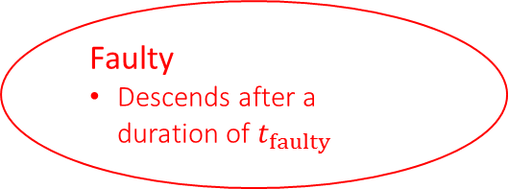
Leave highway
Follow highway
Leader
Leader of platoon
Create new platoon
Merge onto highway
Follow platoon
Merge with platoon in front
Free:
Vehicle not in a platoon or on a highway
Follower
Member of platoon
Join platoon
Leave highway
Faulty
Descends after a duration of $t_{faulty}$

